Slide 1
Chapter 4
Conceptual Modeling of Databases with Entity-Relationship Diagrams and the Unified Modeling Language

Slide 2
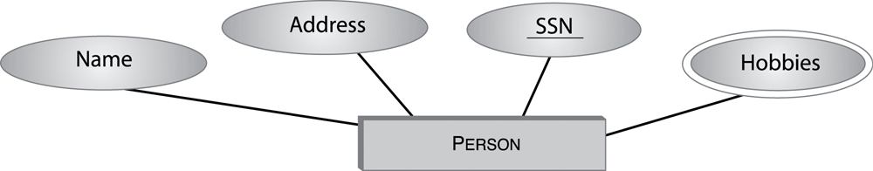
Figure 4.1 Fragment of the E-R diagram for the entity type PERSON.
Copyright © 2005 Pearson Addison-Wesley. All rights reserved.
4-<number>

Slide 3
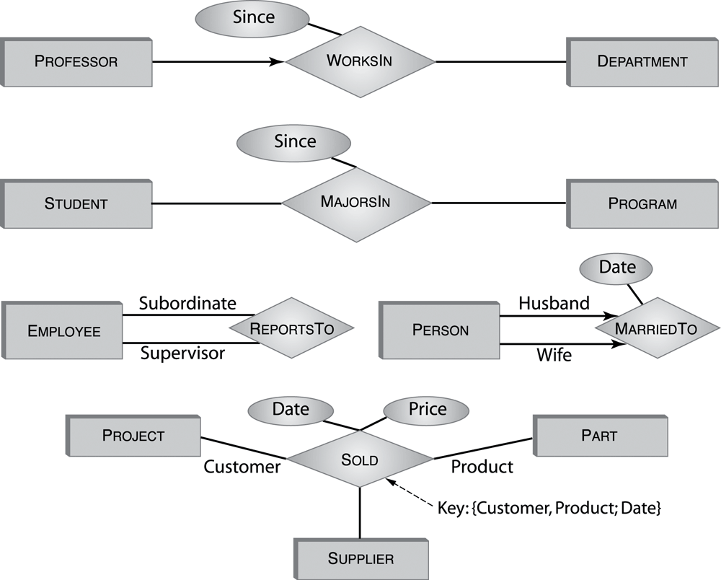
Figure 4.2 E-R diagrams for several relationship types.

Slide 4
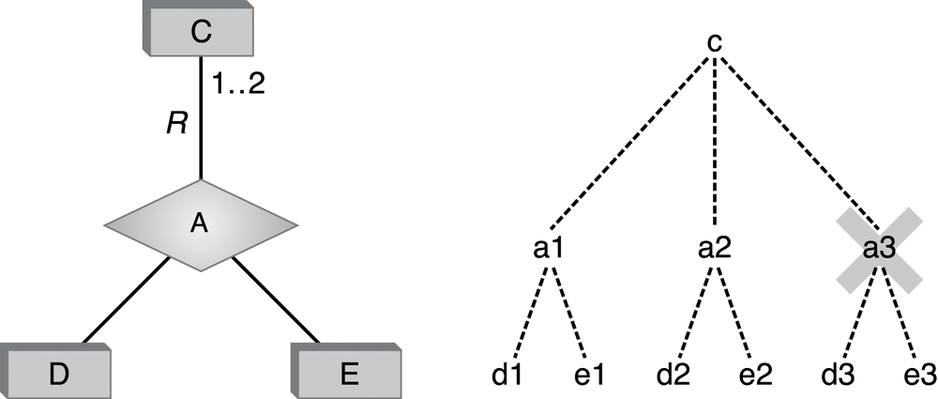
Figure 4.3 Cardinality in the E-R model.
Let C be an entity type and A be a relationship type that is connected to C via a
role, R. A cardinality constraint on the role R is a statement of the form min .. max
attached to R; it restricts the number of relationship instances of type A in which a single entity of type C can participate in role R to be a number in the interval min .. max (with end points included).
Copyright © 2005 Pearson Addison-Wesley. All rights reserved.
4-<number>

Slide 5
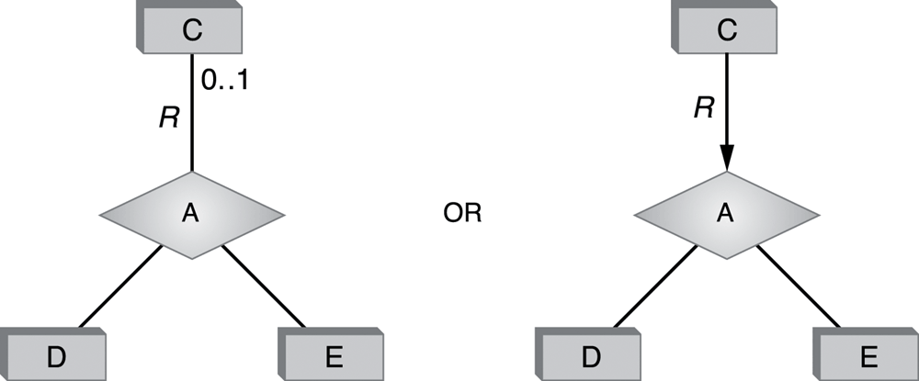
Figure 4.4 Two ways to represent single-role key constraints.
Copyright © 2005 Pearson Addison-Wesley. All rights reserved.
4-<number>

Slide 6
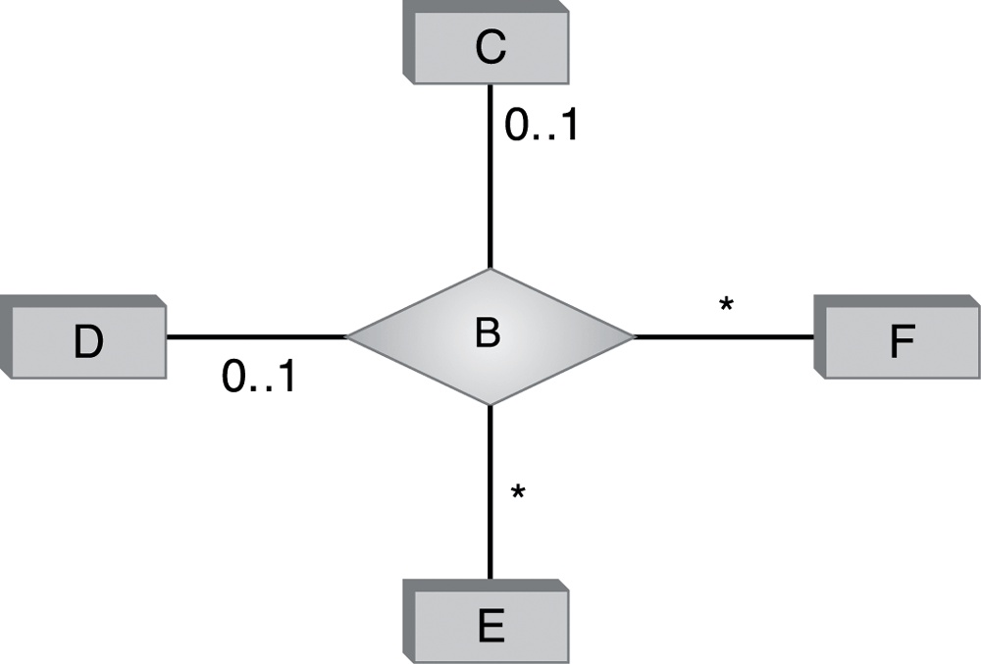
Figure 4.5 Many-to-one, one-to-one, and many-to-many correspondences.
Copyright © 2005 Pearson Addison-Wesley. All rights reserved.
4-<number>

Slide 7
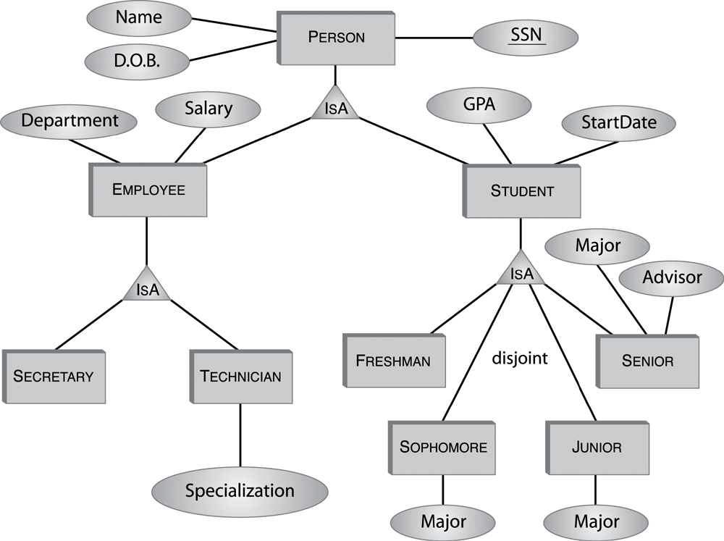
Figure 4.6 Example of an E-R diagram with an ISA hierarchy.
Copyright © 2005 Pearson Addison-Wesley. All rights reserved.
4-<number>

Slide 8
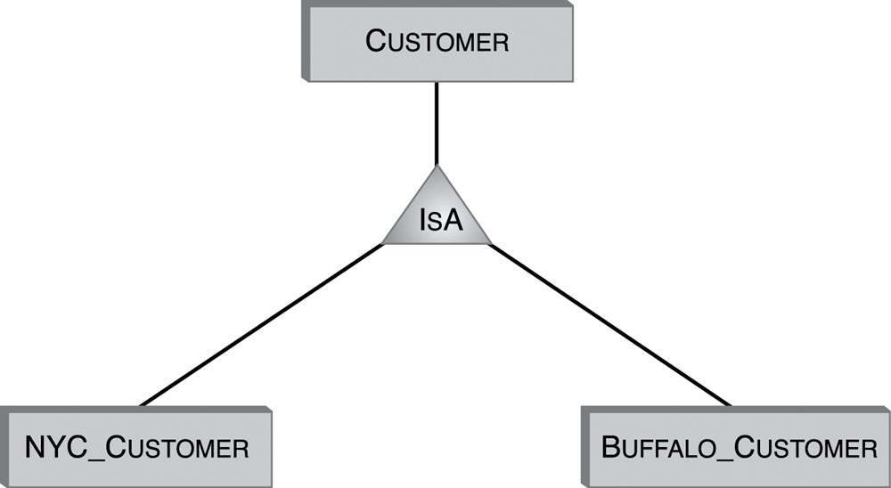
Figure 4.7 Using IsA for data partitioning.
Copyright © 2005 Pearson Addison-Wesley. All rights reserved.
4-<number>

Slide 9
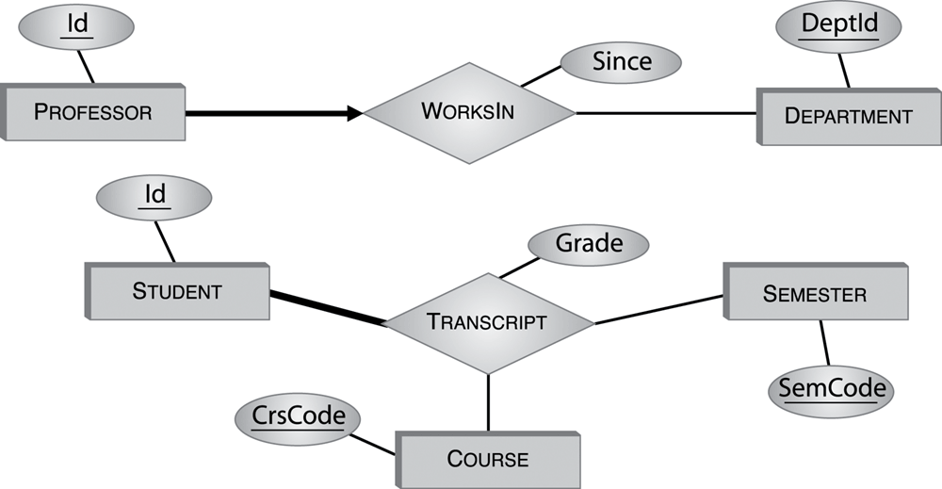
Figure 4.8 Participation constraints.
Copyright © 2005 Pearson Addison-Wesley. All rights reserved.
4-<number>

Slide 10
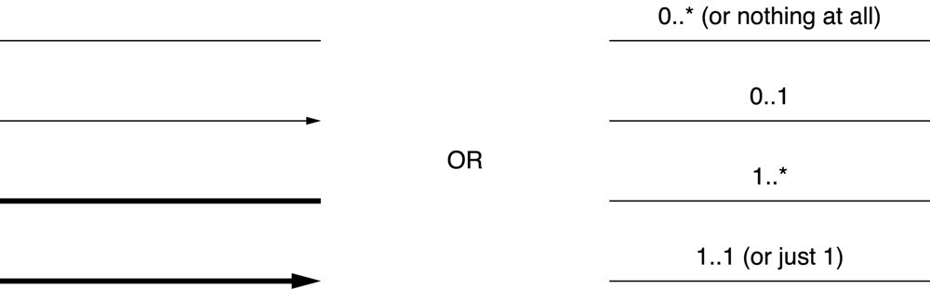
Figure 4.9 Line-based representation vs. cardinality constraints.
Copyright © 2005 Pearson Addison-Wesley. All rights reserved.
4-<number>

Slide 11
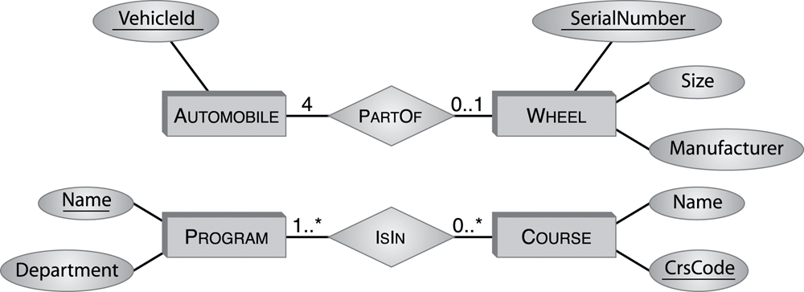
Figure 4.10 Non-exclusive part-of relationship in E-R.
Copyright © 2005 Pearson Addison-Wesley. All rights reserved.
4-<number>

Slide 12
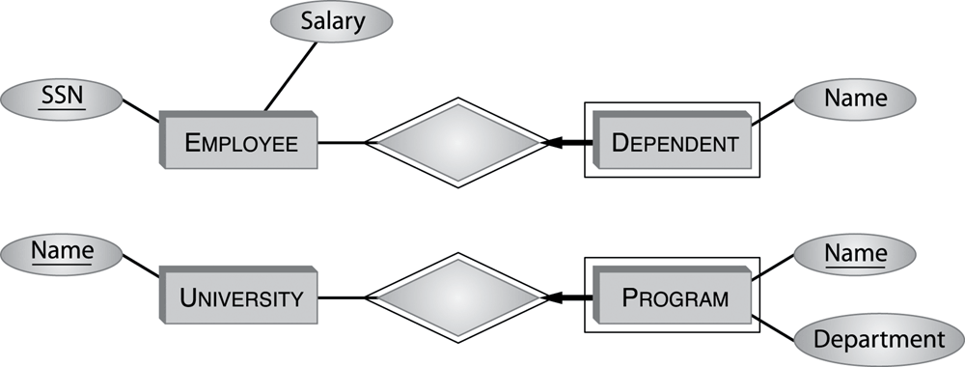
Figure 4.11 Exclusive part-of relationship in E-R: Weak entities.
Weak entity type &
Identifying relationship
Copyright © 2005 Pearson Addison-Wesley. All rights reserved.
4-<number>

Slide 13
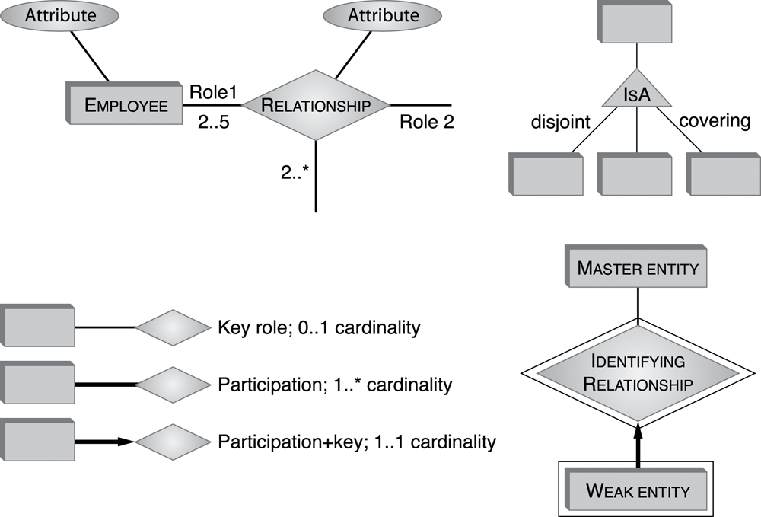
Figure 4.12 Summary of the E-R notation.
Copyright © 2005 Pearson Addison-Wesley. All rights reserved.
4-<number>

Slide 14
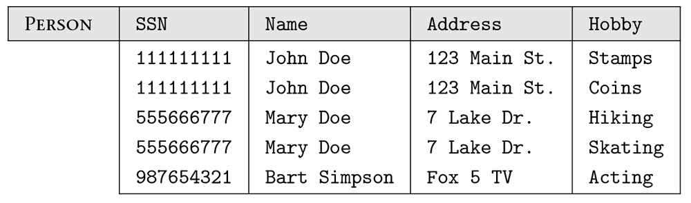
Figure 4.13 Translation of entity type PERSON into a relation.
Copyright © 2005 Pearson Addison-Wesley. All rights reserved.
4-<number>

Slide 15
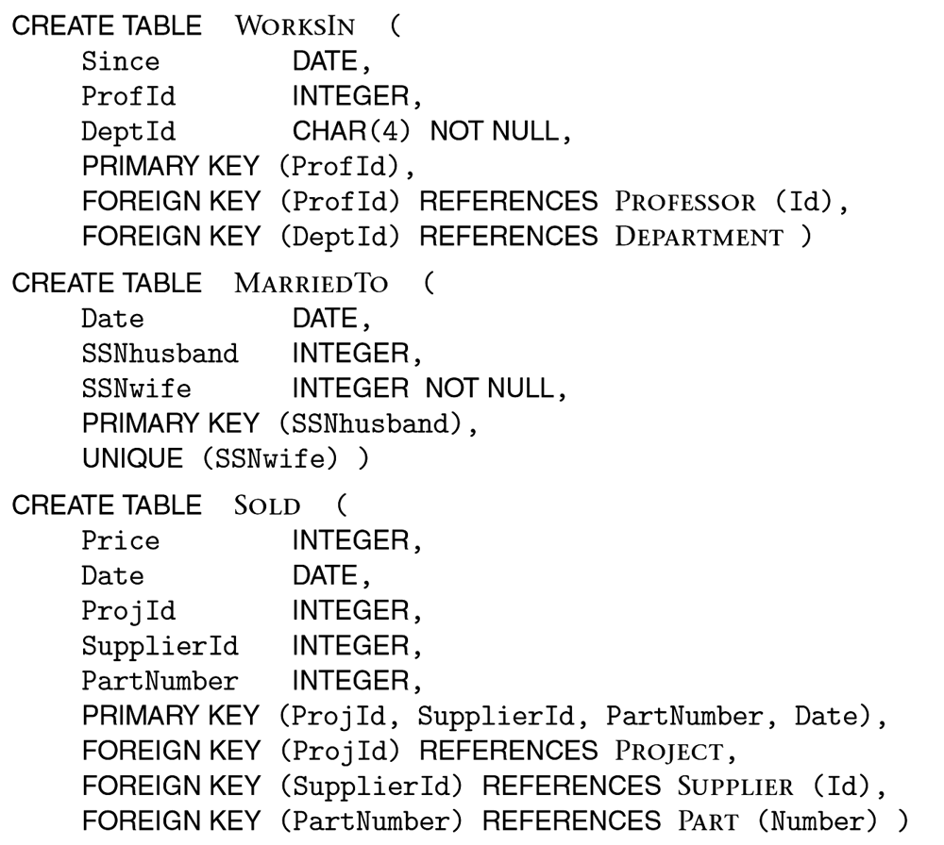
Figure 4.14 Translations of some relationships.
Copyright © 2005 Pearson Addison-Wesley. All rights reserved.
4-<number>

Slide 16
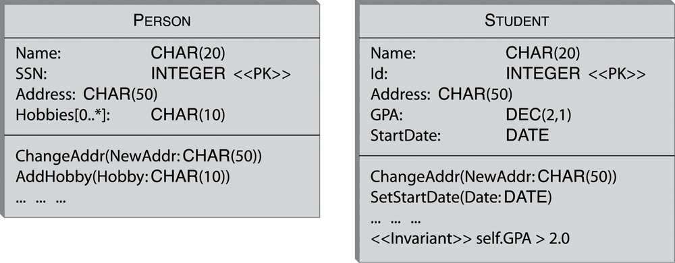
Figure 4.15 Examples of UML classes.
Copyright © 2005 Pearson Addison-Wesley. All rights reserved.
4-<number>

Slide 17
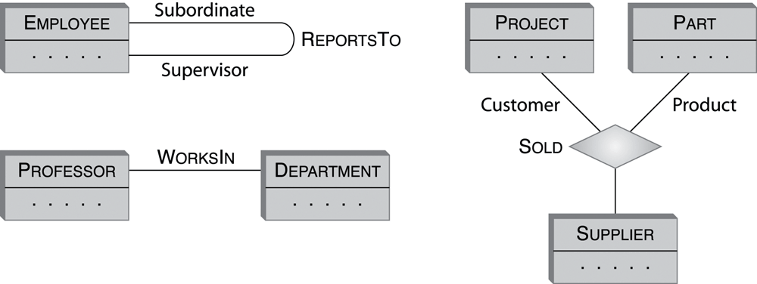
Figure 4.16 UML associations.
Copyright © 2005 Pearson Addison-Wesley. All rights reserved.
4-<number>

Slide 18
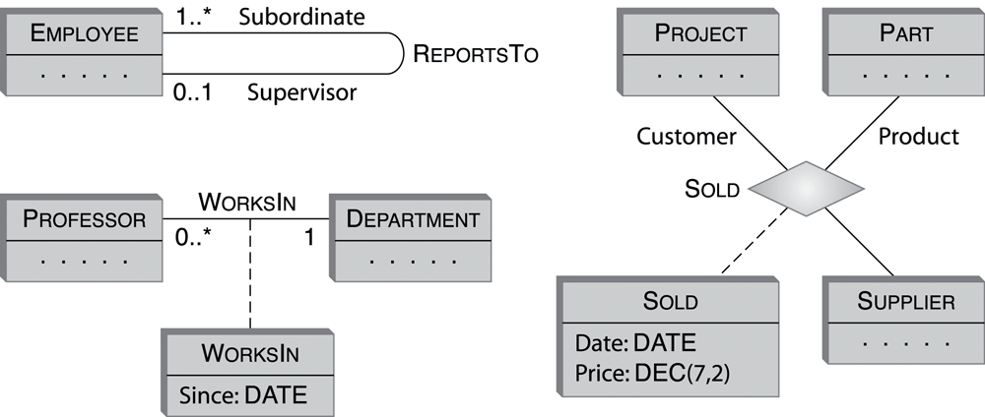
Figure 4.17 UML associations with association classes.
Copyright © 2005 Pearson Addison-Wesley. All rights reserved.
4-<number>

Slide 19
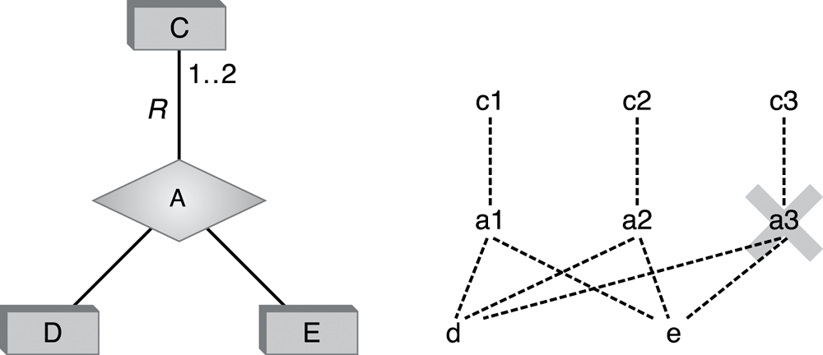
Figure 4.18 The meaning of the multiplicity constraint in UML.
To better understand this concept, take a look at Figure 4.18. In the picture, the class C is connected via the role R to the association type A, and other roles connect the association to classes D and E. The multiplicity constraint on R is 1 .. 2. Therefore, each pair of objects, d∈D and e∈E, must be connected by associations of type A to at least one and at most two objects of class C.
Copyright © 2005 Pearson Addison-Wesley. All rights reserved.
4-<number>

Slide 20
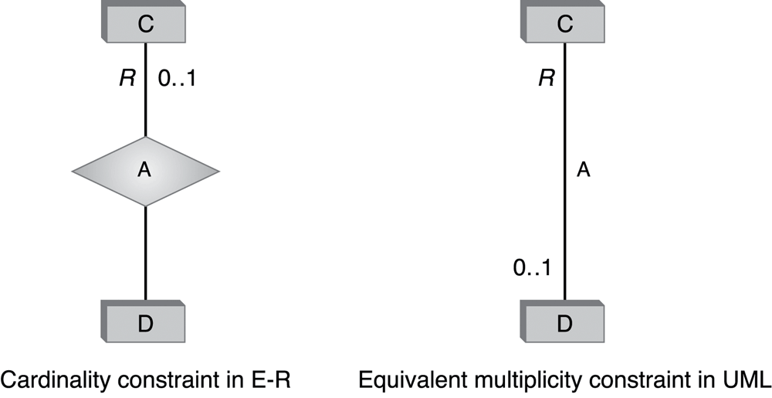
Figure 4.19 Cardinality vs. multiplicity.
Copyright © 2005 Pearson Addison-Wesley. All rights reserved.
4-<number>

Slide 21
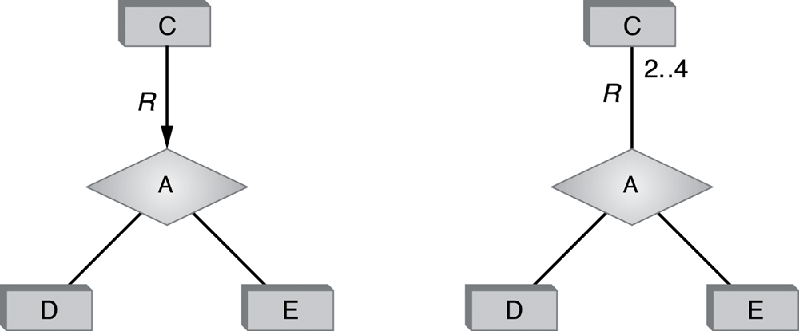
Figure 4.20 Cardinality constraints in E-R that cannot be represented using multiplicity in UML.
Copyright © 2005 Pearson Addison-Wesley. All rights reserved.
4-<number>

Slide 22
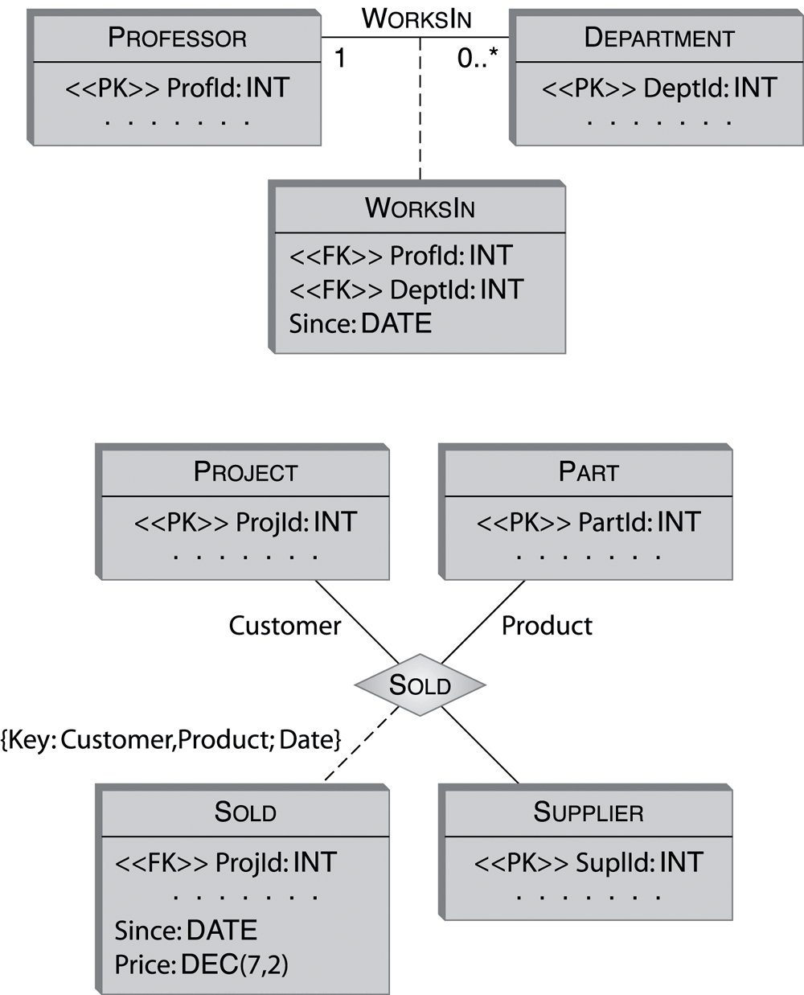
Figure 4.21 Foreign keys in UML.
Copyright © 2005 Pearson Addison-Wesley. All rights reserved.
4-<number>

Slide 23
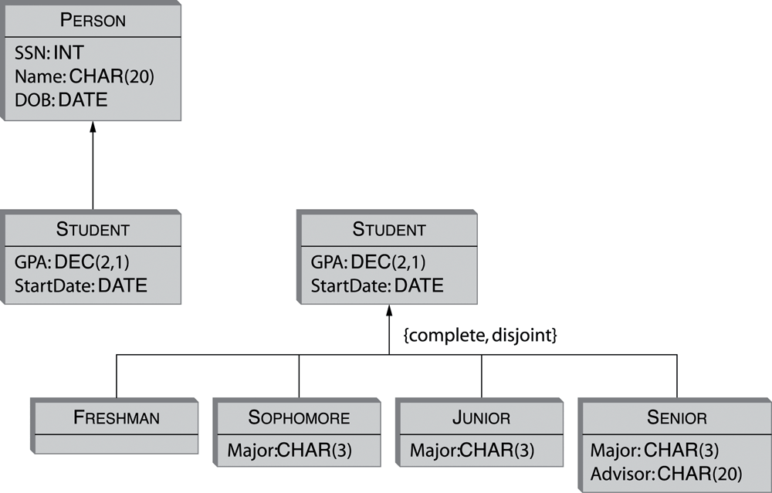
Figure 4.22 IsA (or generalization) hierarchies in UML.
Copyright © 2005 Pearson Addison-Wesley. All rights reserved.
4-<number>

Slide 24
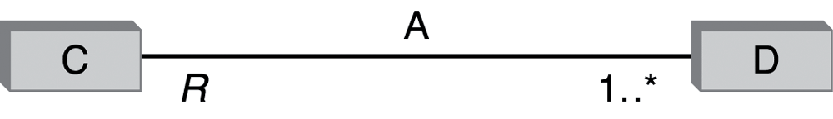
Figure 4.23 UML representation of the participation constraint for class C in binary association type A.
Copyright © 2005 Pearson Addison-Wesley. All rights reserved.
4-<number>

Slide 25
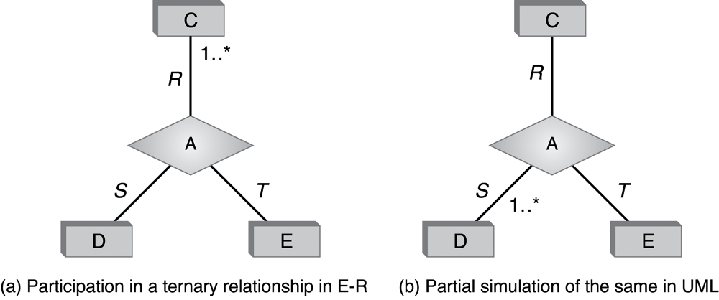
Figure 4.24 Participation constraints for ternary relationships.
Copyright © 2005 Pearson Addison-Wesley. All rights reserved.
4-<number>

Slide 26
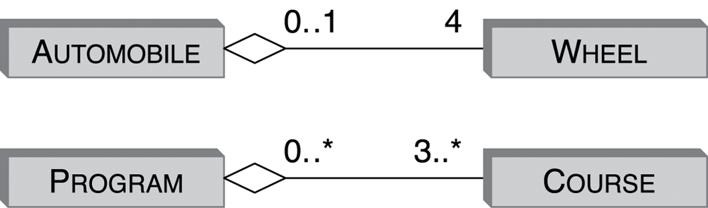
Figure 4.25 Aggregation: non-exclusive part-of association in UML.
Copyright © 2005 Pearson Addison-Wesley. All rights reserved.
4-<number>

Slide 27
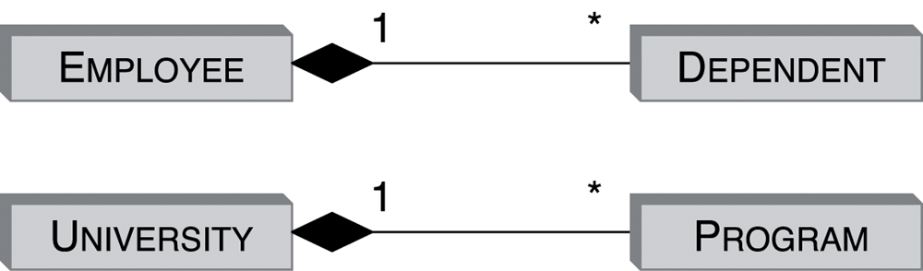
Figure 4.26 Composition: exclusive part-of association in UML.
Copyright © 2005 Pearson Addison-Wesley. All rights reserved.
4-<number>

Slide 28
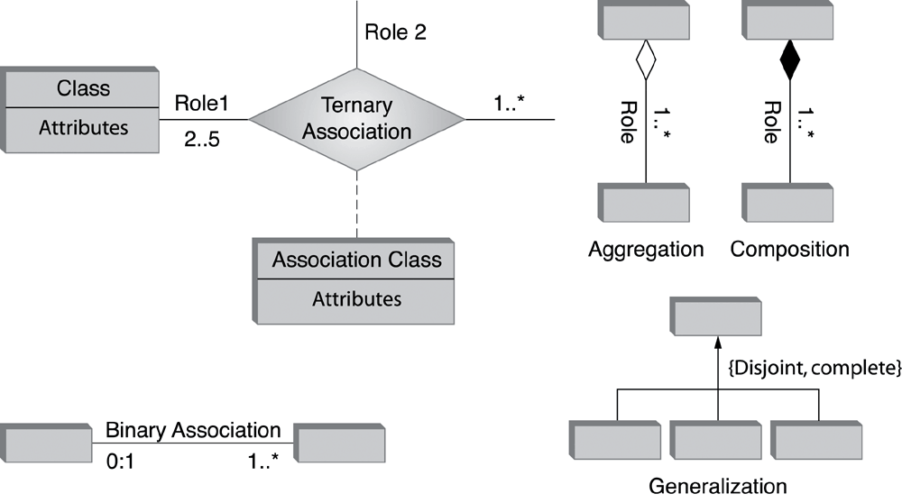
Figure 4.27 Summary of the UML notation.
Copyright © 2005 Pearson Addison-Wesley. All rights reserved.
4-<number>

Slide 29
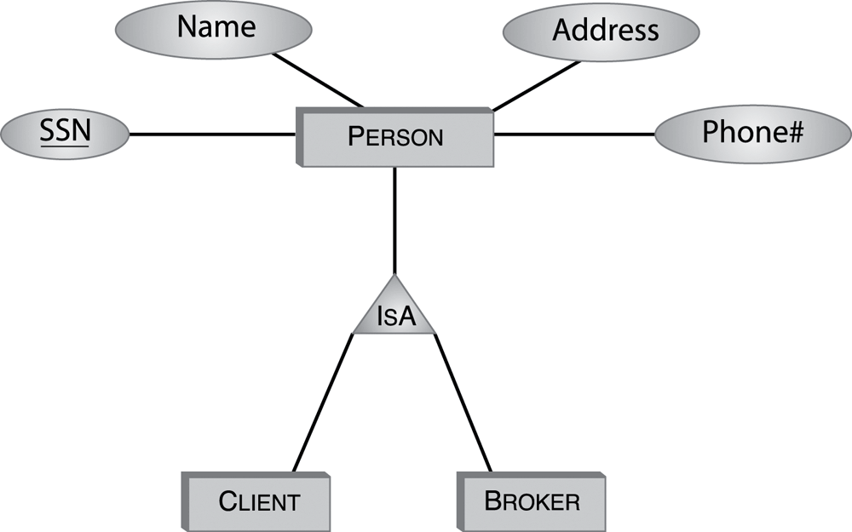
Figure 4.28 The IsA hierarchy of the PSSC enterprise.
Copyright © 2005 Pearson Addison-Wesley. All rights reserved.
4-<number>

Slide 30
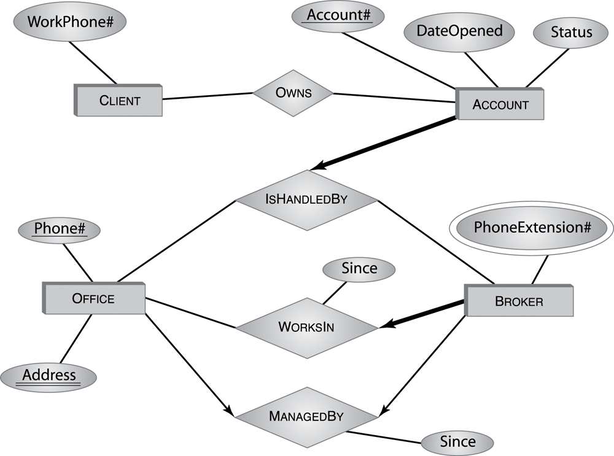
Figure 4.29 Client/broker information: first attempt.
Copyright © 2005 Pearson Addison-Wesley. All rights reserved.
4-<number>

Slide 31
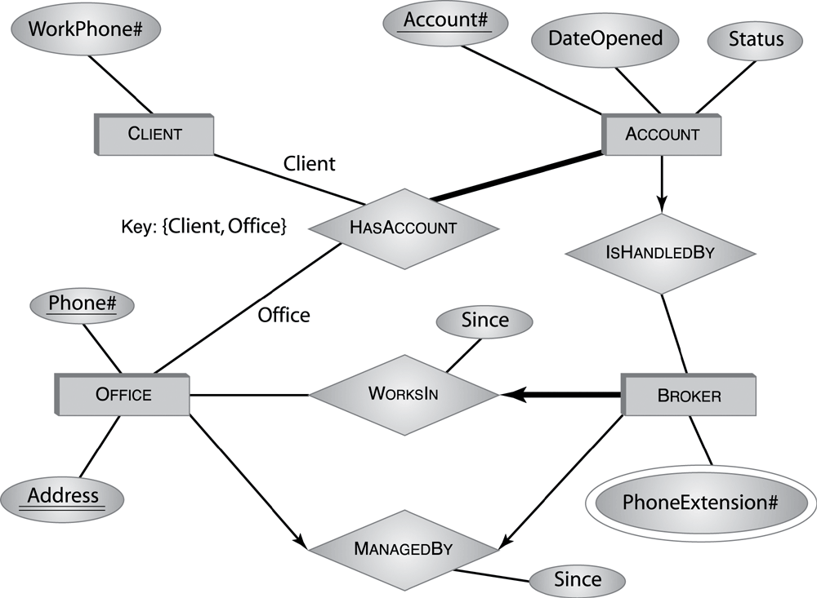
Figure 4.30 Client/broker information: second try.
Navigation Trap
Copyright © 2005 Pearson Addison-Wesley. All rights reserved.
4-<number>

Slide 32
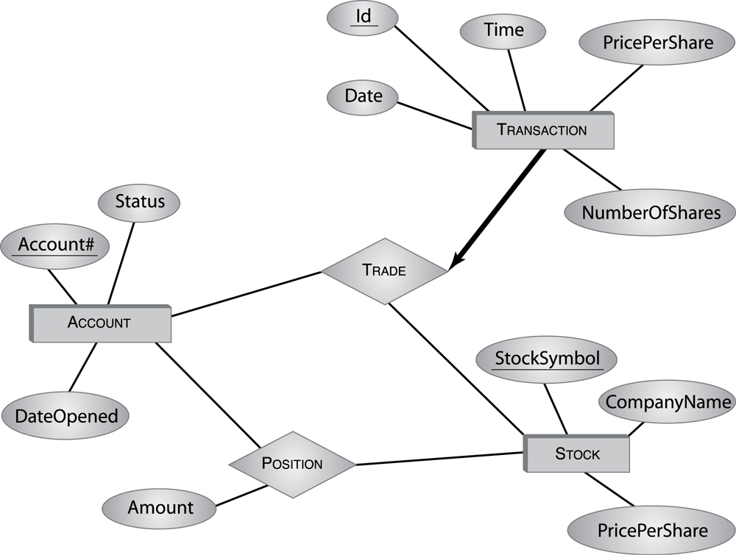
Figure 4.31 Trading information in the PSSC enterprise.
Copyright © 2005 Pearson Addison-Wesley. All rights reserved.
4-<number>

Slide 33
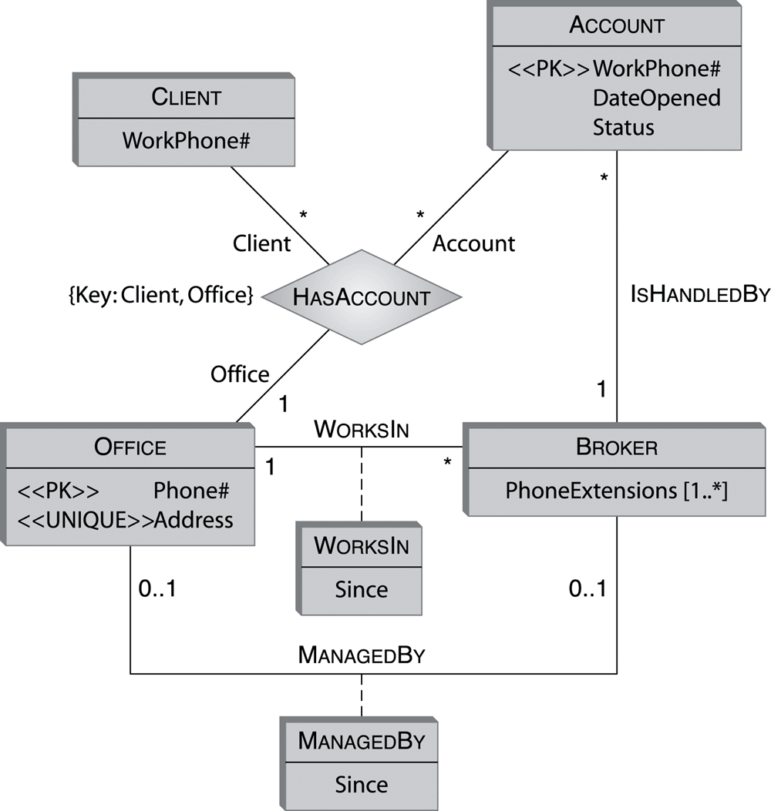
Figure 4.32 Client/broker information in UML.
Copyright © 2005 Pearson Addison-Wesley. All rights reserved.
4-<number>

Slide 34
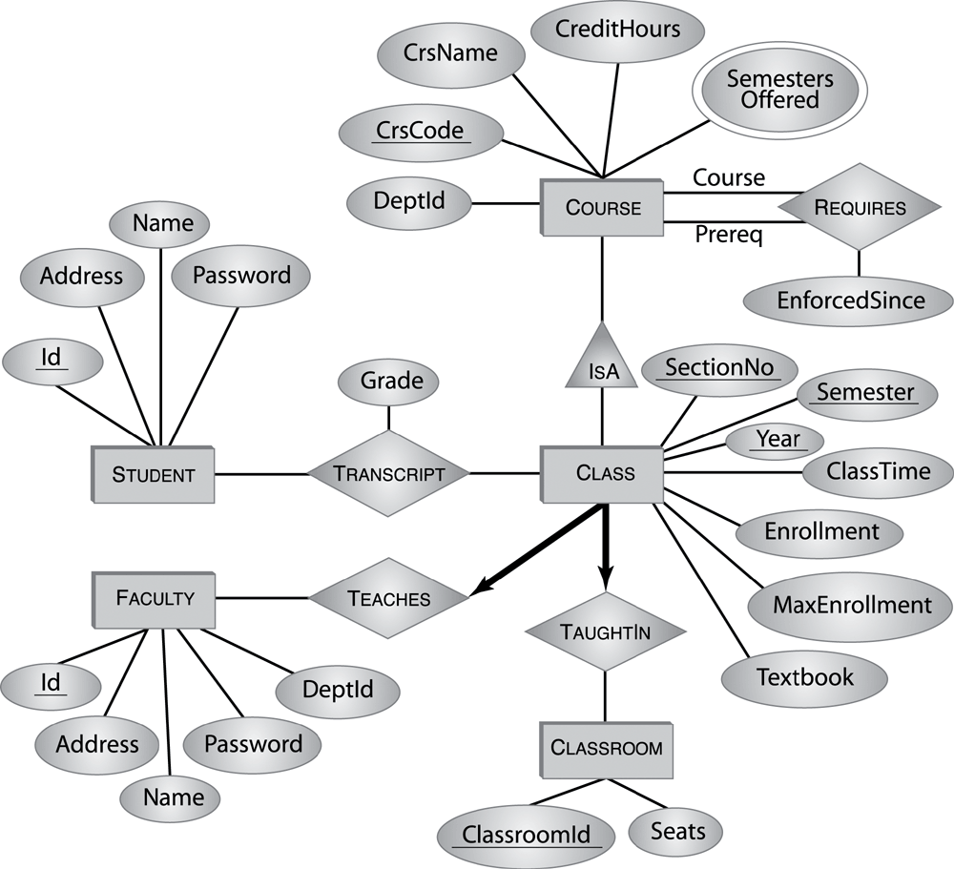
Figure 4.33 An E-R diagram for the Student Registration System.

Slide 35
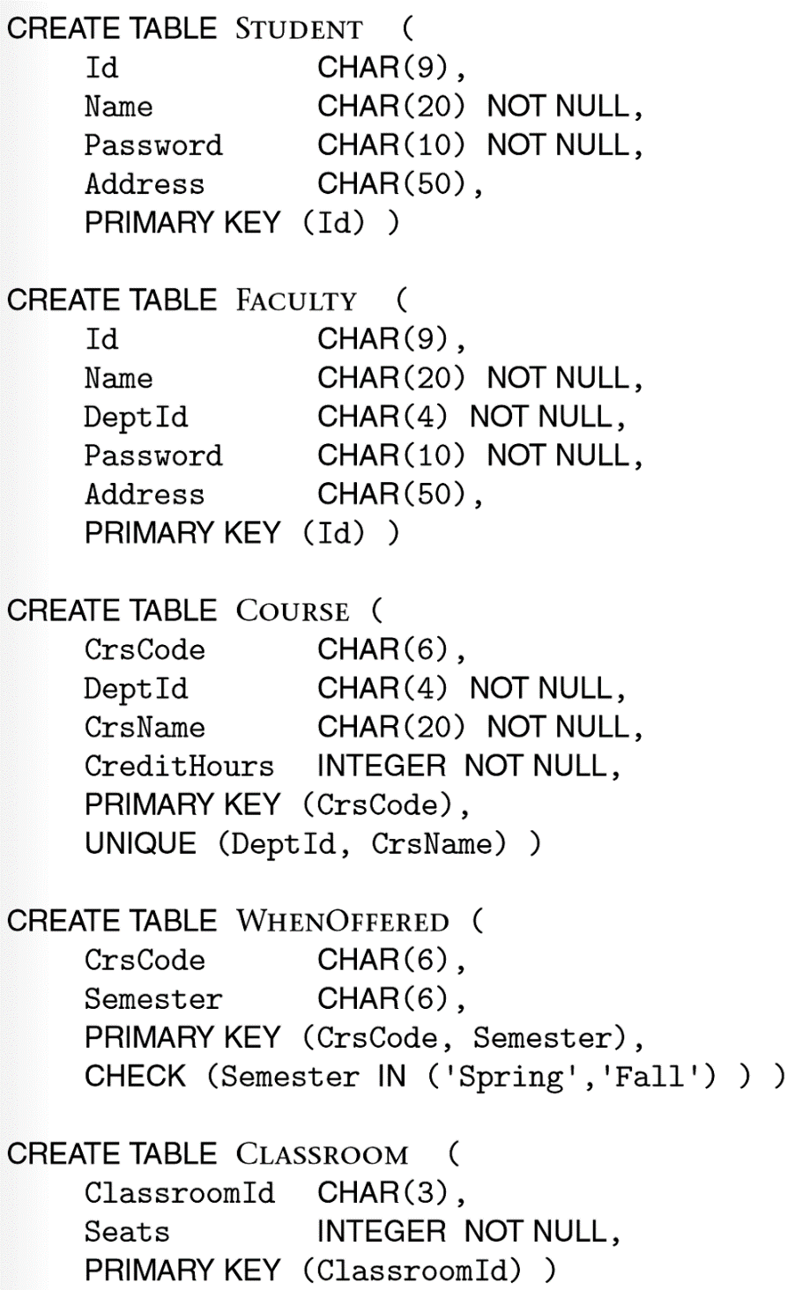
Figure 4.34
A schema for the Student Registration System—Part 1.
Copyright © 2005 Pearson Addison-Wesley. All rights reserved.
4-<number>

Slide 36
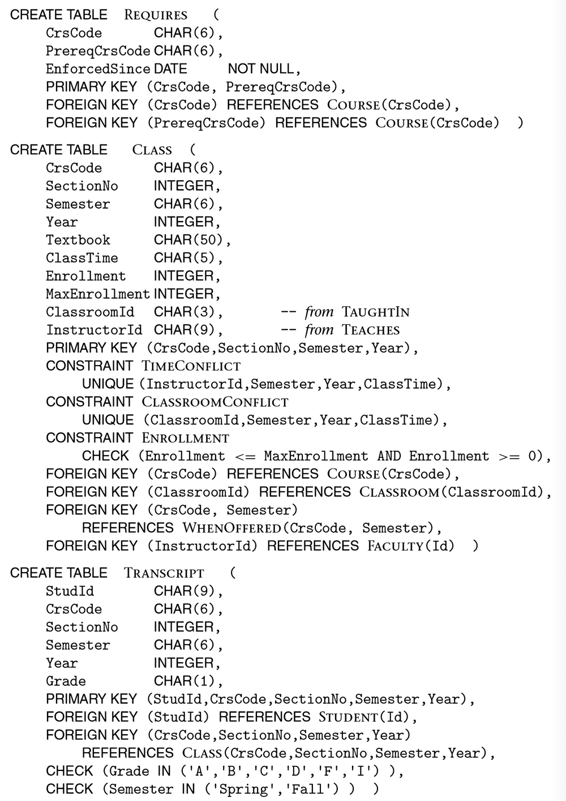
Figure 4.35
A schema for the Student Registration System—Part 2.
Copyright © 2005 Pearson Addison-Wesley. All rights reserved.
4-<number>

Slide 37
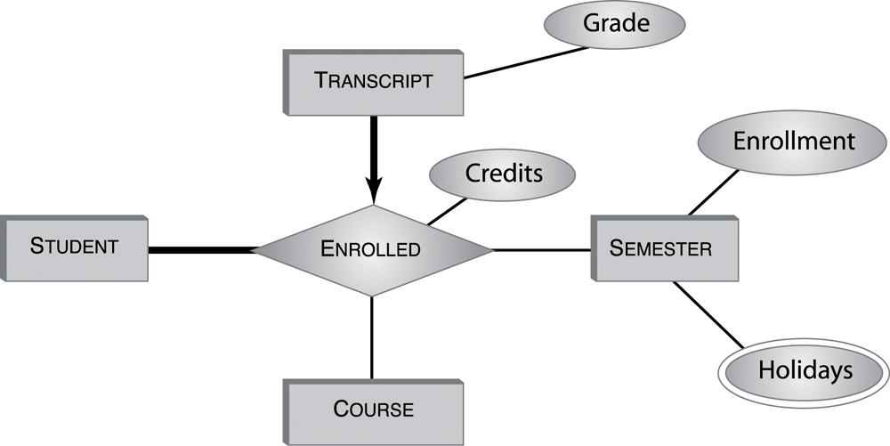
Figure 4.36 An alternative representation of the transcript information.
Copyright © 2005 Pearson Addison-Wesley. All rights reserved.
4-<number>

Slide 38
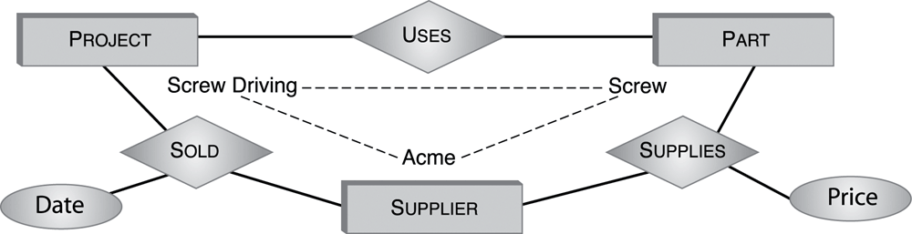
Figure 4.37 Replacing the ternary relationship SOLD of Figure 4.2 with three binary relationships.
Copyright © 2005 Pearson Addison-Wesley. All rights reserved.
4-<number>

Slide 39
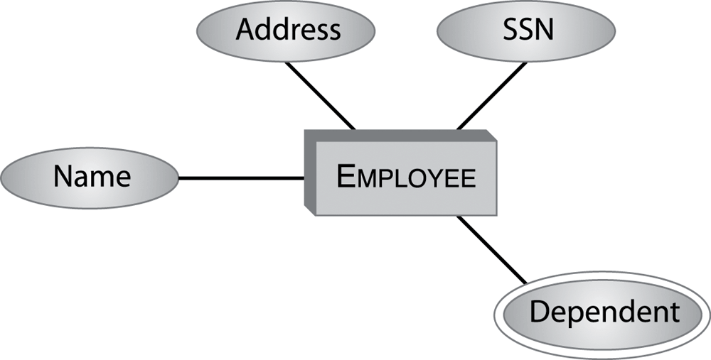
Figure 4.38 E-R diagram for Exercise 4.17.
Copyright © 2005 Pearson Addison-Wesley. All rights reserved.
4-<number>

